Slide 1
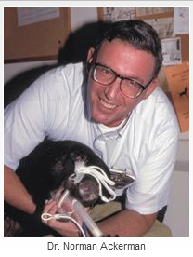
Dr. Norman Ackerman served the University of Florida, College of Veterinary Medicine with distinction as Professor of Radiology from 1979 to 1994. A concerned teacher of veterinary students and residents of all disciplines, Dr. Ackerman also reached the veterinary scientific community through his writing. His numerous clinically pertinent publications are still today a vital part of the veterinary literature; therefore, it is appropriate this site perpetuates Dr Ackerman’s dedication to teaching. This site is presented in recognition of Dr. Norman Ackerman and his contributions to the field of veterinary diagnostic imaging.
Sponsorship of the display supports the Dr. Norman Ackerman Memorial Fund, dedicated to the teaching of diagnostic imaging residents at the University of Florida College of Veterinary Medicine.
Next slide

Slide 2
Norman Ackerman Memorial Radiography Case Challenge
10 years old MI German Shepherd dog
Next Slide

Slide 3
Signalment
2 day history of lethargy and inappetence;
Mildly elevated ALT.
You ordered thoracic radiographs
Next Slide

Slide 4
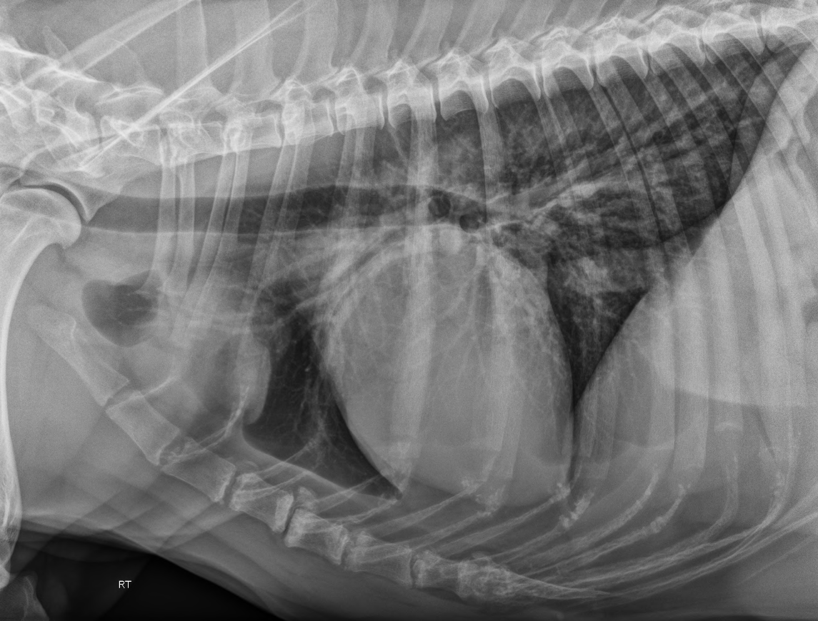
Previous Slide
Next Slide

Slide 5
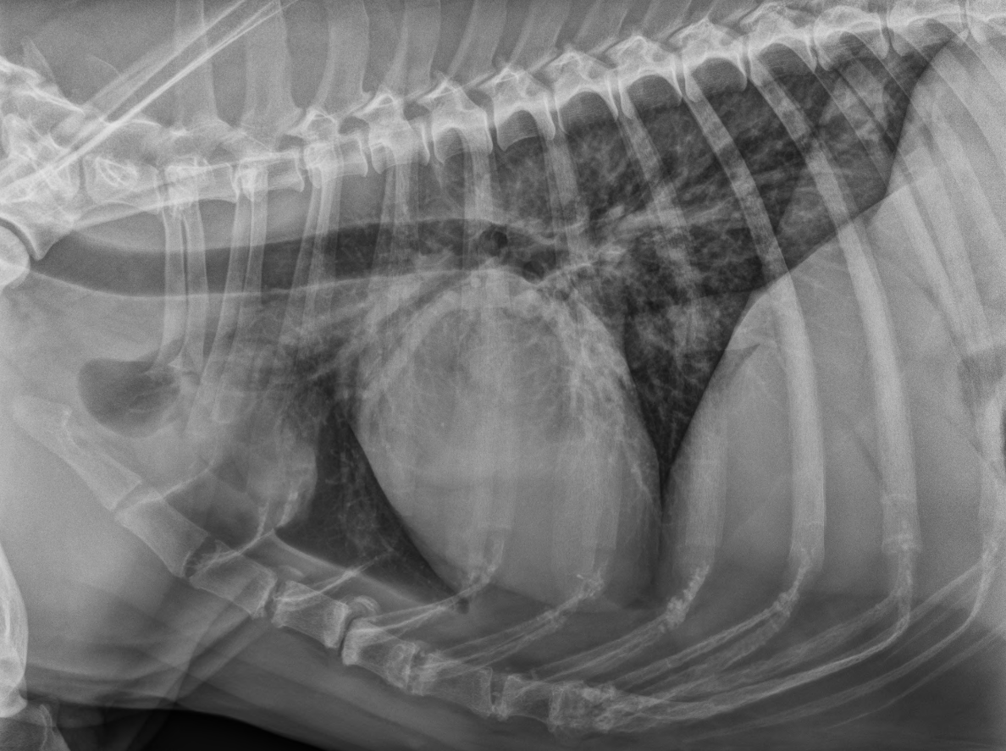
Previous Slide
Next Slide

Slide 6
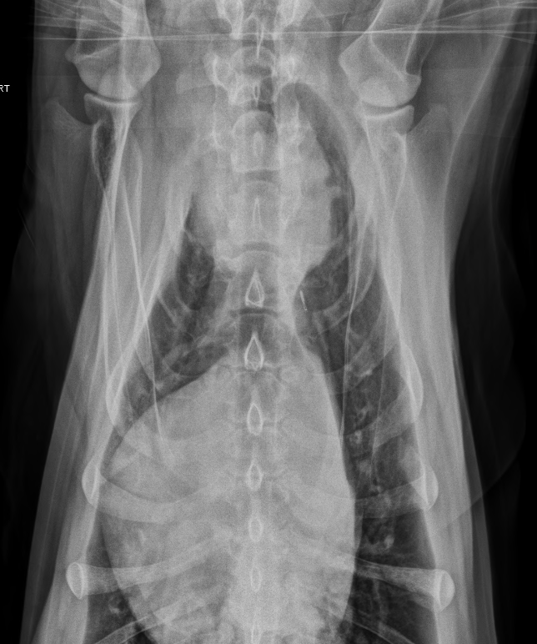
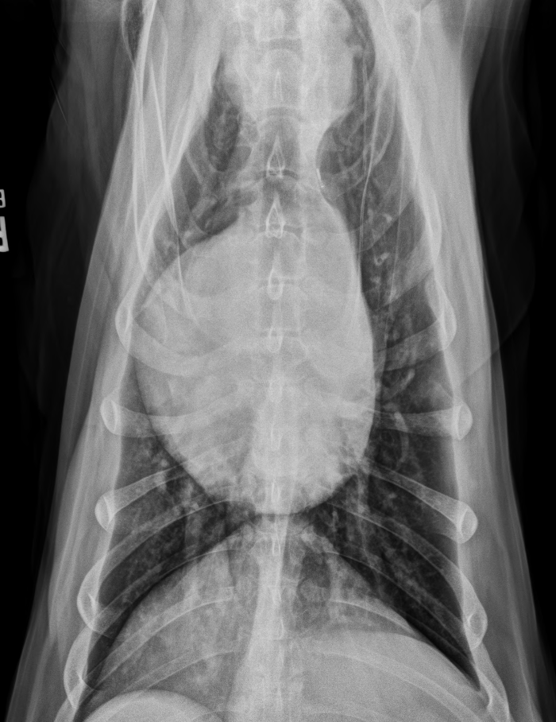
Previous Slide
Next Slide

Slide 7
Based on your assessment of the radiographs, the thoracic body wall (including the osseous structures and portion of the cranial abdomen included in the collimation) is:
Abnormal
Normal

Slide 8
Correct!
There are S4-5 subluxation (white circle) and multifocal sternebral degenerative changes.
Next Slide

Slide 9
Sorry!
There are S4-5 subluxation (white circle) and multifocal sternebral degenerative changes.
Click here to proceed to the next question

Slide 10
Based on your assessment of the radiographs, the pleural space is:
Normal
Abnormal

Slide 11
Correct!
There are no abnormalities associated with the pleural space.
Next Slide

Slide 12
Sorry!
The pleural space is normal
Click here to proceed to the next question

Slide 13
Based on your evaluation, the cardiac silhouette is:
Normal
Abnormal

Slide 14
Sorry…almost
The cardiac silhouette is within normal limits for size and shape, however it is mildly deviated to the right
Click here to continue

Slide 15
Correct!
There are no abnormalities of size and shape associated with the cardiac silhouette, however it is mildly deviated to the right
Next slide

Slide 16
Based on your assessment, the remainder of the mediastinal structures (excluding the cardiac silhouette) are:
Normal
Abnormal

Slide 17
Sorry!
There is an abnormality associated with the mediastinum.
Try again!

Slide 18
Correct!
In the cranioventral mediastinal reflection, just dorsal to the second sternebra, there is a 7.5 cm round, well-defined soft tissue opaque mass which causes widening of the cranial mediastinum.
Continue

Slide 19
Based on your assessment of the radiographs, the lungs, including the pulmonary vessels, are:
Normal
Abnormal

Slide 20
Sorry!
There is an abnormality associated with the lungs.
Try again!

Slide 21
Correct!
There is mild diffuse reticular to linear increase in soft tissue opacity throughout the lung lobes, that partially hampers the evaluation of the pulmonary vasculature.
Next slide

Slide 22
Conclusion
Your findings now include:
Cranioventral mediastinal mass
Mild diffuse unstructured interstitial pulmonary pattern – more likely due to senile pulmonary interstitial fibrosis
Possible S4-5 subluxation and multifocal sternebral degenerative changes.
What are your differential diagnosis for the cranioventral mediastinal mass?
click next.

Slide 23
Conclusion
Sternal lymphadenopathy;
Atypically located thymoma, thymic lymphoma, histiocytic sarcoma, or ectopic thyroid tissue cannot be excluded.
Then, Abdominal US + US-guided FNA of the cranial mediastinal mass were performed.
click next.

Slide 24
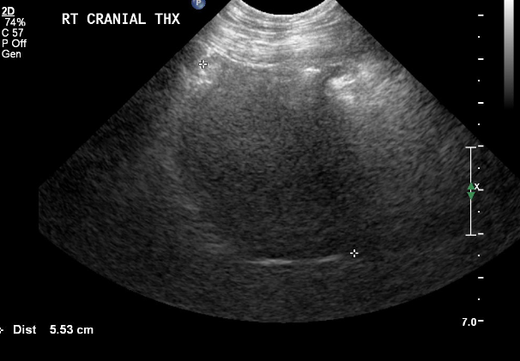
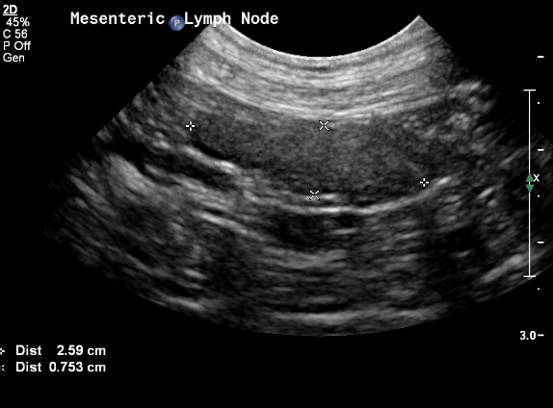
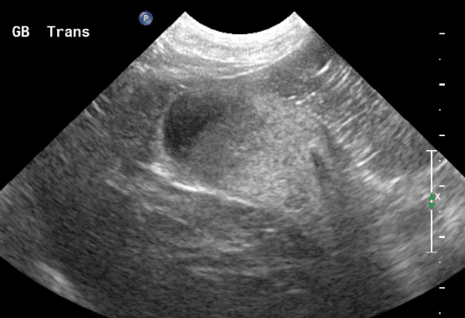
US images
click next.

Slide 25
US report
Within the gallbladder, there is a moderate amount of gravity dependent echogenic material;
There is a heterogeneous mildly enlarged mesenteric lymph node measuring 2.5 x 1.1 x 0.7 cm;
Within the cranial mediastinum, there is a hypoechoic mass. This mass has no blood flow as seen with color flow Doppler.
click next.

Slide 26
US impressions
Cranial mediastinal mass; consider neoplasia such as thymoma, thymic lymphoma, histiocytic sarcoma, or ectopic thyroid tissue;
Mesenteric lymphadenopathy; consider reactive or neoplastic etiologies;
Gallbladder sludge. The possibility of cholecystitis cannot be ruled out.
click next.

Slide 27
FNA results
Thymoma
click next.

Slide 28
Take Home Message 1
In this case, the shape, opacity, and location of the cranial mediastinal mass is likely to be related to sternal lymphadenomegaly;
In a recent study, neoplastic disease was observed in association with sternal lymph node enlargement in approximately 79% of dogs and 69% in cats (Smith & O’Brien, 2012 - JAAHA);
The sternal lymph nodes drain approximately four-fifths of the peritoneal space, as well as portions of the sternal, costal and lumbar areas (Smith & O’Brien, 2012 - JAAHA). That is why is so important to perform abdominal US in these cases, in order to find the underline cause of the possible sternal lymph node enlargement!!
click next.

Slide 29
Take Home Message 2
Due to its rounded, homogeneous and hypoechoic appearance on the US examination, thymoma, thymic lymphoma, and others cranial mediastinal cyst-like lesions were placed higher on the differential diagnostic list;
Usually, thymic neoplasias are diagnosed in mid age to senile dogs (Faisca et al., 2011 - JSAP), and, in one study, German Shepherd dogs and Labrador Retrievers were over-represented (Day, 1997 - JSAP).
Return to the webpage
Return to the beginning of the case

